Slide 1
Decision Tree Algorithm
جامعة البعث
الكلية التطبيقية
السنة الثالثة
قواعد معطيات 3
المحاضرة الثالثة (عملي)
Prepered By
Eng : Danny Wassouf

Slide 2
Outline
Introduction: Data Mining and Classification
Classification
Decision trees
  Splitting attribute
  Information gain and gain ratio
  Missing values
  Pruning
  From trees to rules

Slide 3
Data Growth
Large DB examples as of 2003:
  France Telecom has largest decision-support DB, ~30TB; AT&T ~ 26 TB
  Alexa internet archive: 7 years of data, 500 TB
  Google searches 3.3 Billion pages, ? TB
Twice as much information was created in 2002 as in 1999 (~30% growth rate)
Knowledge Discovery is NEEDED to make sense and use of data.

Slide 4
Classification
Classification is a most common machine learning and data mining task.
Given past “classified” cases, and a new “unclassified” case, learn a model that fits past cases and predicts the class of the new case.
Decision Trees are one of most common methods to build a model
Applications: Diagnostics, Prediction in medicine, business, science, etc …

Slide 5
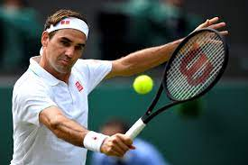
Weather Data: Play or not Play?
Outlook | Temperature | Humidity | Windy | Play?
sunny | hot | high | false | No
sunny | hot | high | true | No
overcast | hot | high | false | Yes
rain | mild | high | false | Yes
rain | cool | normal | false | Yes
rain | cool | normal | true | No
overcast | cool | normal | true | Yes
sunny | mild | high | false | No
sunny | cool | normal | false | Yes
rain | mild | normal | false | Yes
sunny | mild | normal | true | Yes
overcast | mild | high | true | Yes
overcast | hot | normal | false | Yes
rain | mild | high | true | No

Slide 6
Example Tree for “Play?”
For
Outlook=sunny,
Humidity=normal,
Windy=true
Play = ?
Outlook
sunny
overcast
rain
Humidity
Yes
Windy
high
normal
true
false
No
Yes
No
Yes

Slide 7
DECISION TREE
An internal node is a test on an attribute.
A branch represents an outcome of the test, e.g., Color=red.
A leaf node represents a class label or class label distribution.
At each node, one attribute is chosen to split training examples into distinct classes as much as possible
A new case is classified by following a matching path to a leaf node.

Slide 8
Building A Decision Tree
Top-down tree construction
  At start, all training examples are at the root.
  Partition the examples recursively by choosing one attribute each time.
Bottom-up tree pruning
  Remove sub-trees or branches, in a bottom-up manner, to improve the estimated accuracy on new cases.

Slide 9
Choosing the Splitting Attribute
At each node, available attributes are evaluated on the basis of separating the classes of the training examples. A goodness function is used for this purpose.
Typical goodness functions:
  information gain (ID3/C4.5)
  information gain ratio
  gini index

Slide 10
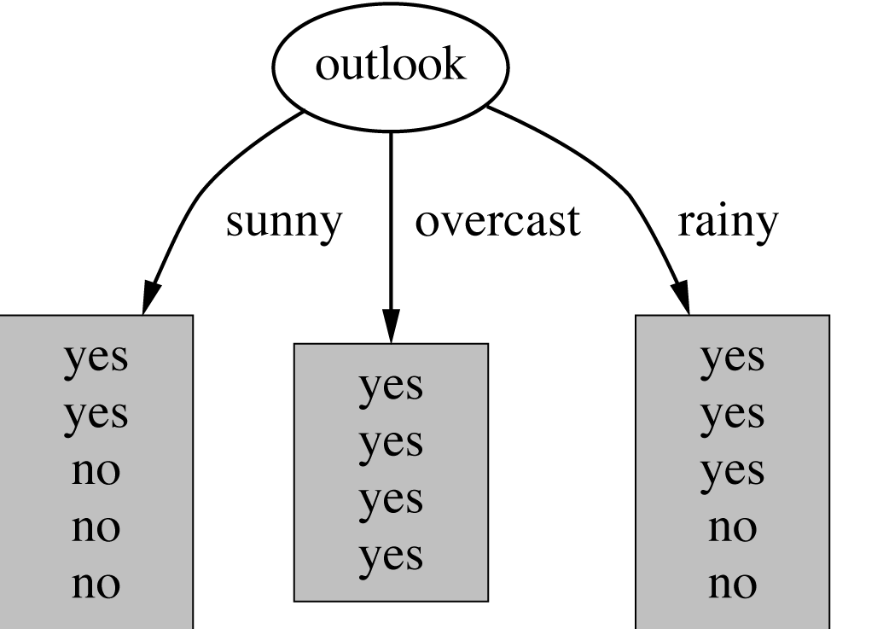
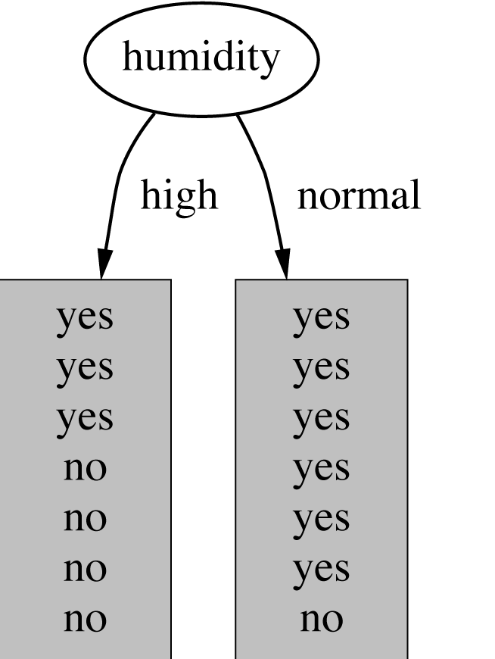
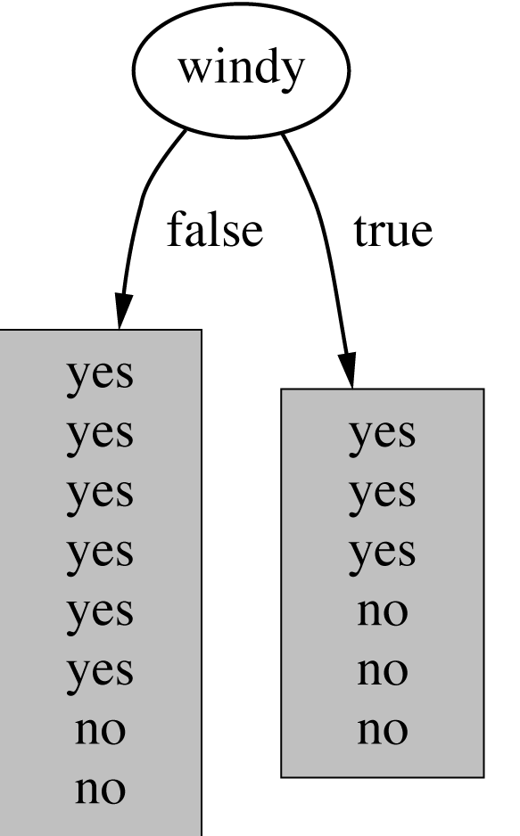
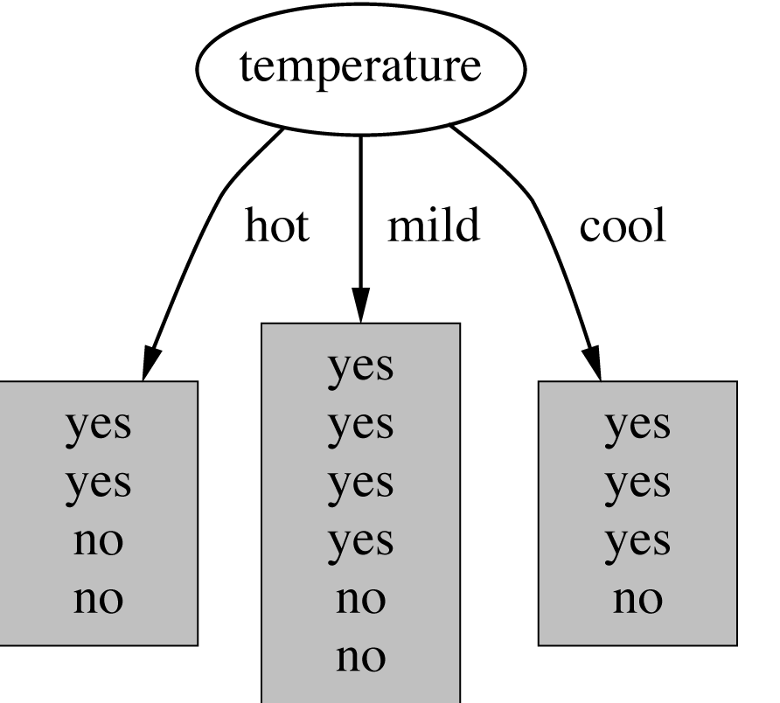
Which attribute to select?
witten&eibe

Slide 11
A criterion for attribute selection
Which is the best attribute?
  The one which will result in the smallest tree
  Heuristic: choose the attribute that produces the “purest” nodes
Popular impurity criterion: information gain
  Information gain increases with the average purity of the subsets that an attribute produces
Strategy: choose attribute that results in greatest information gain
witten&eibe

Slide 12
Computing information
Information is measured in bits
  Given a probability distribution, the info required to predict an event is the distribution’s entropy
  Entropy gives the information required in bits (this can involve fractions of bits!)
Formula for computing the entropy:
witten&eibe

Slide 13

Example: attribute “Outlook”
“Outlook” = “Sunny”:
“Outlook” = “Overcast”:
“Outlook” = “Rainy”:
Expected information for attribute:
Note: log(0) is not defined, but we evaluate 0*log(0) as zero
witten&eibe

Slide 14


Computing the information gain
Information gain:
(information before split) – (information after split)
Information gain for attributes from weather data:
witten&eibe

Slide 15
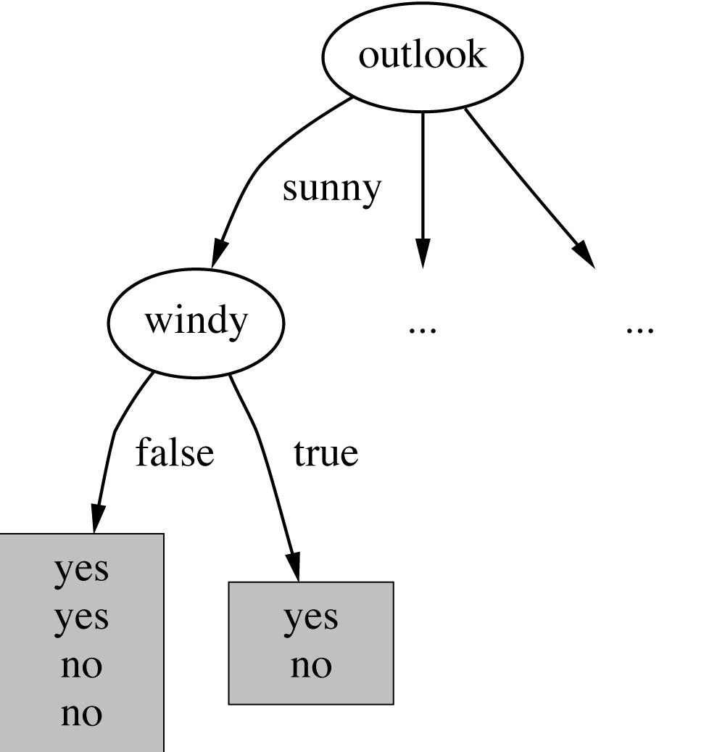
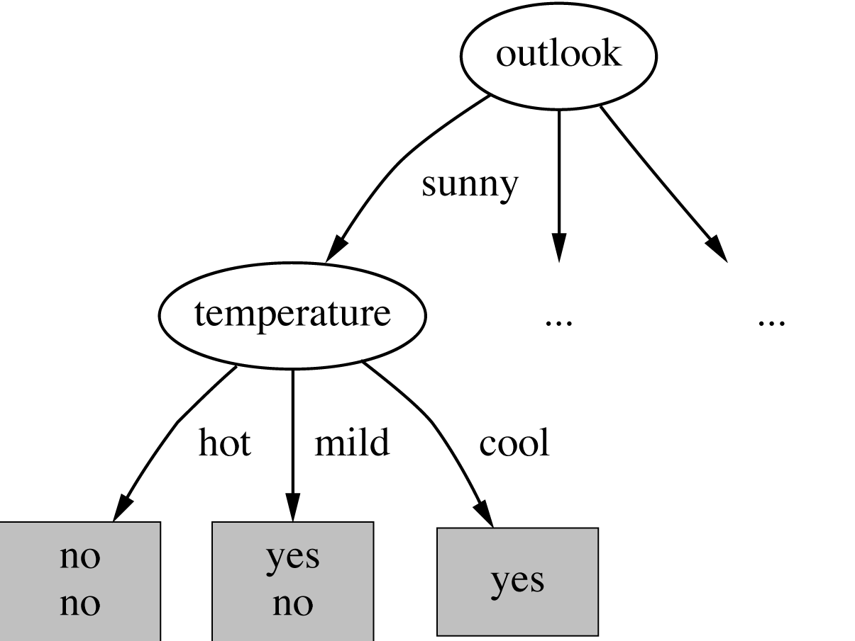
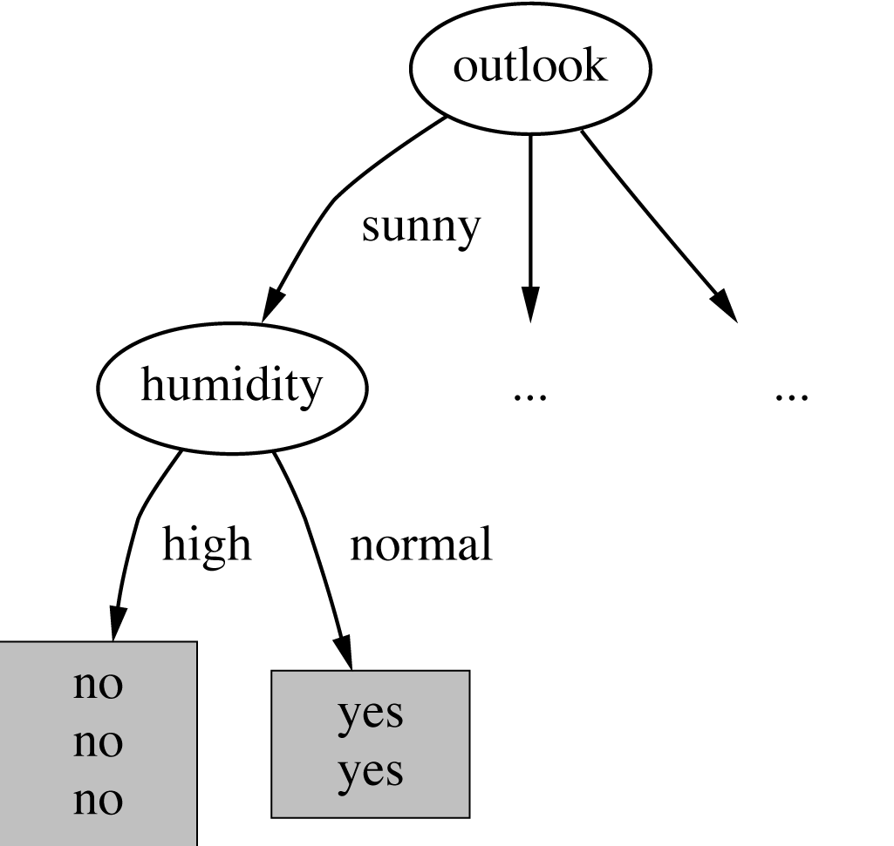

Continuing to split
witten&eibe

Slide 16
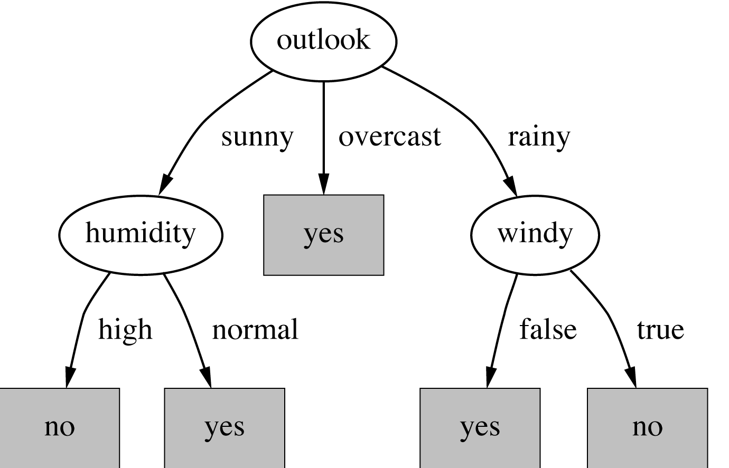
The final decision tree
Note: not all leaves need to be pure; sometimes identical instances have different classes
  ⇒ Splitting stops when data can’t be split any further
witten&eibe

Slide 17
Thank you

